Slide 1
Climate Change Accuracy:
Requirements and Economic Value
Bruce Wielicki, NASA Langley
Roger Cooke, Resources for the Future
Rosemary Baize, NASA Langley
Martin Mlynczak, NASA Langley
Constantin Lukashin, NASA Langley
Kurt Thome, NASA GSFC
GOESS 3rd Science and Technology Workshop
"Navigating Sustainability of a Changing Planet"
Joint Session: Linking Science, Metrics, and Observation Systems
Norfolk, VA
March 25, 2015

Slide 2
Charney Report, 1979
Concerning Anthropogenic Climate Change:
“In order to address this question in its entirety, one would have to peer into the world of our grandchildren, the world of the twenty-first century.”
Foreword by Vern Suomi

Slide 3
Charney Report, 1979
Concerning Anthropogenic Climate Change:
“In order to address this question in its entirety, one would have to peer into the world of our grandchildren, the world of the twenty-first century.”
Foreword by Vern Suomi

Slide 4
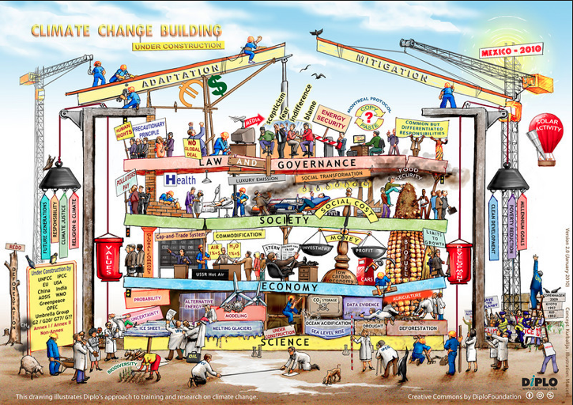
35 Years Later …

Slide 5
35 Years Later …

Slide 6
35 Years Later … More urgent, but …
Lack of a climate observing system (vs. weather)
  Climate is 10x the variables and 10x the accuracy of weather.
Struggles to get sufficient resources for climate modeling
Science questions typically qualitative not quantitative
  Understand and explore vs rigorous hypothesis testing
  Leads to intuitive “Seat of the Pants” requirements
  After > 30 years of climate research: time to improve
What is the right amount to invest in climate science?
  Requires link of science to economics
  Requires thinking outside narrow disciplines
  Requires arguing for climate science, not our own science

Slide 8
Accuracy of Climate Change Observations & Predictions
Trenbrerth et al. 2013

Slide 9
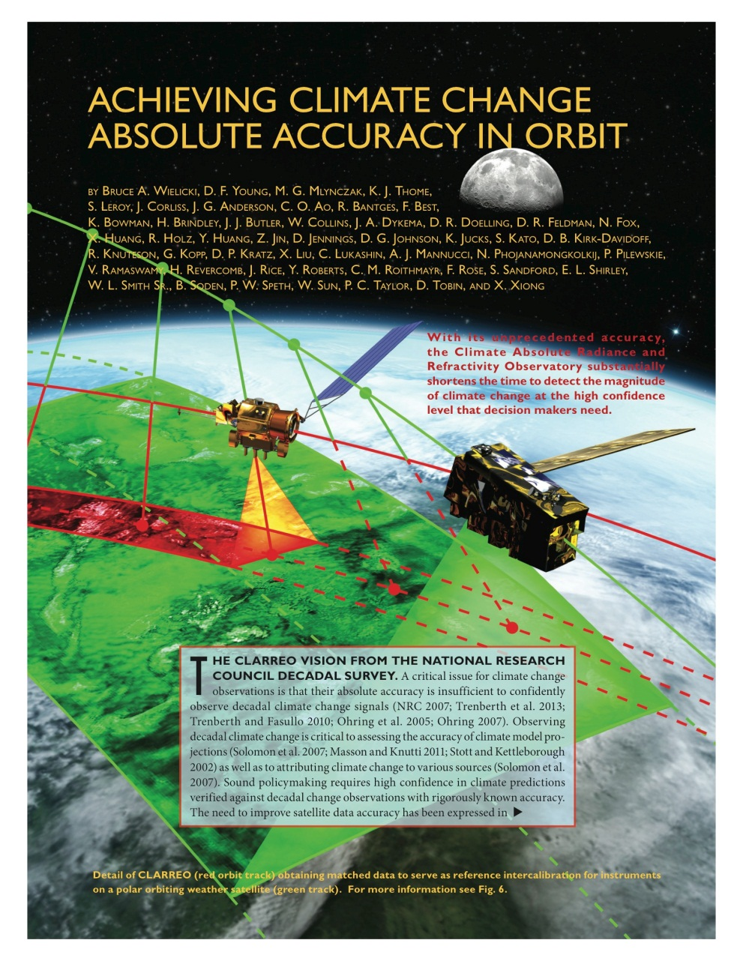
BAMS October, 2013

Slide 10
Accuracy Requirements of the Climate Observing System
The length of time required to detect a climate trend caused by human activities is determined by:
Natural variability
The magnitude of human driven climate change
The accuracy of the observing system
Uncertainty of Observable Trend
Even a perfect observing system is limited by natural variability

Slide 11
Reflected Solar Accuracy and Climate Trends
Climate Sensitivity Uncertainty
is a factor of 4 (IPCC, 90% conf)
which =factor of 16 uncertainty in
climate change economic impacts
Climate Sensitivity Uncertainty =
Cloud Feedback Uncertainty =
Low Cloud Feedback =
Changes in SW CRF/decade
(y-axis of figure)
Higher Accuracy Observations =
CLARREO reference intercal of
CERES = narrowed uncertainty
15 to 20 years earlier
Wielicki et al. 2013,
Bulletin of the American Meteorological Society
High accuracy is critical to more rapid understanding of climate change

Slide 12
What is the right amount to invest in climate science?
Global Value of Improved Climate Information
NASA CLARREO Climate Accuracy Framework (BAMS, 2013)
Interagency Memo on Social Cost of Carbon (2010)
Integrated Climate /Economic Model (DICE, 2009)
Cooke et al., Journal of Environment, Systems, and Decisions, July 2013,
paper has open and free distribution online: doi:10.1007/s10669-013-9451-8
Interdisciplinary Integration of Climate Science and Economics

Slide 13
VOI Estimation Method
BAU Emissions
Climate Sensitivity
Climate Change
Economic Impacts

Slide 14
VOI Estimation Method
BAU Emissions
Climate Sensitivity
Climate Change
Economic Impacts
Fuzzy
Lens #1
Fuzzy
Lens #2
Natural Variability Uncertainty
Observing System Uncertainty
Societal Decision

Slide 15
VOI Estimation Method
BAU Emissions
Climate Sensitivity
Climate Change
Economic Impacts
Reduced Emissions
Climate Sensitivity
Reduced
Climate Change
Reduced Economic Impacts
Fuzzy
Lens #1
Fuzzy
Lens #2
Natural Variability Uncertainty
Observing System Uncertainty
Societal Decision

Slide 16
VOI Estimation Method
BAU Emissions
Climate Sensitivity
Climate Change
Economic Impacts
Reduced Emissions
Climate Sensitivity
Reduced
Climate Change
Reduced Economic Impacts
Fuzzy
Lens #1
Fuzzy
Lens #2
Natural Variability Uncertainty
Observing System Uncertainty
Societal Decision
Climate Science VOI

Slide 17
Economics: The Big Picture
World GDP today ~ $70 Trillion US dollars
Net Present Value (NPV)
  compare a current investment to other investments that could have been made with the same resources
Discount rate: 3%
  10 years: discount future value by factor of 1.3
  25 years: discount future value by factor of 2.1
  50 years: discount future value by factor of 4.4
  100 years: discount future value by factor of 21
Business as usual climate damages in 2050 to 2100: 0.5% to 5% of GDP per year depending on climate sensitivity.

Slide 18
VOI vs. Discount Rate
Run 1000s of economic simulations and then average over
the full IPCC distribution of possible climate sensitivity
Discount Rate | CLARREO/Improved Climate Observations VOI (US 2015 dollars, net present value)
2.5% | $17.6 T
3% | $11.7 T
5% | $3.1 T
Additional Cost of an advanced climate observing system:
~ $10B/yr worldwide
Cost for 30 years of such observations is ~ $200 to $250B (NPV)
Even at the highest discount rate, return on investment is very large

Slide 19
VOI vs. Discount Rate
Run 1000s of economic simulations and then average over
the full IPCC distribution of possible climate sensitivity
Discount Rate | CLARREO/Improved Climate Observations VOI (US 2015 dollars, net present value)
2.5% | $17.6 T
3% | $11.7 T
5% | $3.1 T
Advanced Climate Observing System:
Return on Investment: $50 per $1
Cost of Delay: $650B per year
Even at the highest discount rate, return on investment is very large

Slide 20
Climate Observations: No Long Term Plan
Global Satellite Observations without long term commitments
  Radiation Budget (e.g. CERES)
  Gravity (ice sheet mass) (e.g. GRACE)
  Ice Sheet Elevation (e.g. ICESAT/Cryosat)
  Sea Level Altimetry (e.g. JASON)
  Sea surface Salinity (e.g. Aquarius)
  Cloud and Aerosol Profiles (e.g. CALIPSO/Cloudsat, EarthCARE)
  Precipitation (e.g. GPM, CloudSat/EarthCARE)
  Soil Moisture (e.g. SMAP)
  Ocean surface winds (e.g. QuickSCAT)
  Carbon Source/Sinks (e.g. OCO)
  Methane/Carbon Monoxide (MOPPIT)
  In orbit Calibration References (e.g. CLARREO)
Surface and In-situ observations have similar issues

Slide 21
Suggested Directions
Quantitative Science Questions
  Hypothesis Tests not “improve and explore”, think Higgs Boson
Observing System Simulation Experiments (OSSEs)
  Improve observing system requirements
  Move from “base state” to “climate change” climate model tests
Higher Accuracy Observations for Climate Change
  See BAMS Oct 2013 paper for example: broadly applicable
Economic Value of Improved Climate Observations and Models
  See J. Env. Sys. Decisions paper for example: broadly applicable

Slide 22
Summary
Lack of accuracy = delayed knowledge
We lack a climate observing system capable of testing climate predictions with sufficient accuracy or completeness
At our current pace, its seems unlikely that we will understand climate change even after another 35 years.
We cannot go back in time and measure what we failed to observe.
Its time to invest in an advanced climate observing system

